Slide 1
Mansa Musa
1280-1337

Slide 2
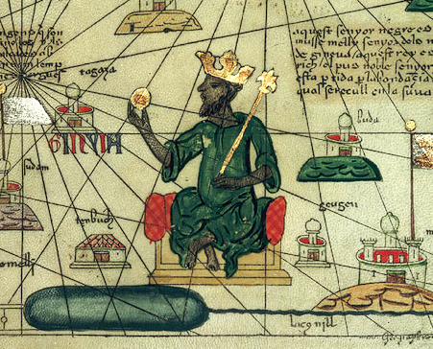
Mansa Musa (1280-1337)
Notes:
Image retrieved from http://en.wikipedia.org/wiki/File:Mansa_Musa.jpg

Slide 3
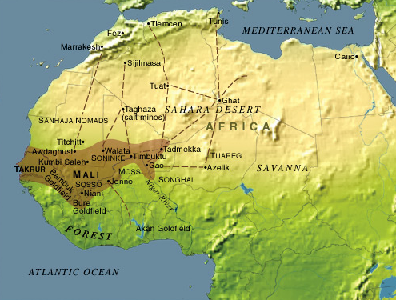
Mali Empire, 1350
Notes:
Image retrieved from http://www.metmuseum.org/toah/hd/gold/hd_gold.htm

Slide 4
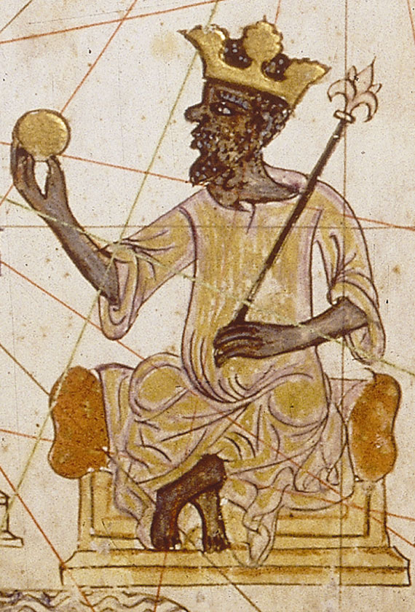
Mansa Musa’s Wealth
Notes:
Image retrieved from http://www.contemporarybalears.com/balears/index.php?section=gallery&cid=1&pId=18

Slide 5
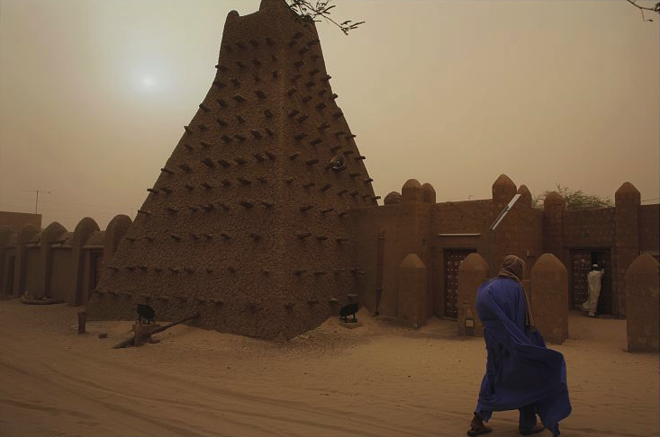
Mansa Musa’s Reign
Sankore Mosque, Timbuktu
Notes:
Image retrieved from http://www.loc.gov/pictures/item/2010648388/

Slide 6
Central Historical Question
Was Mansa Musa the richest person ever?

Slide 7
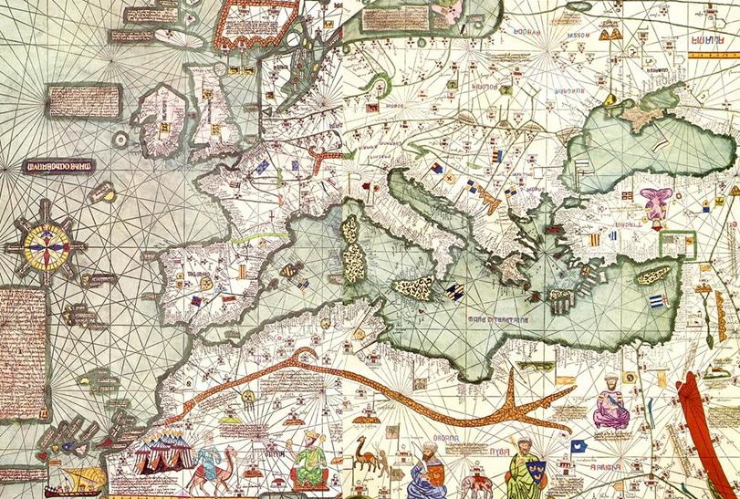
Document B: The Catalan Atlas, 1375
Notes:
Image retrieved from http://en.wikipedia.org/wiki/File:Europe_Mediterranean_Catalan_Atlas.jpeg

Slide 8
The Catalan Atlas
“This Black lord is called Musa Mali, Lord of the Black people of Mali.
So abundant is the gold which is found in his country that he is the
richest and most noble king in all the land.”—Catalan Atlas inscription
Notes:
Image retrieved from http://www.loc.gov/rr/amed/guide/afr-encounters.html

